Slide 1
B - TREE

Slide 2
B - Tree
In search trees like binary search tree, AVL Tree, Red-Black tree, etc., every node contains only one value (key) and a maximum of two children.
But there is a special type of search tree called B-Tree in which a node contains more than one value (key) and more than two children
B-Tree was developed in the year 1972 by Bayer and McCreight with the name Height Balanced m-way Search Tree. Later it was named as B-Tree.

Slide 3
B – Tree(cont.)
B-Tree Defination :
B-Tree is a self-balanced search tree in which every node contains multiple keys and has more than two children
But Here, the number of keys in a node and number of children for a node depends on the order of B-Tree. Every B-Tree has an order

Slide 4
B – Tree properties
B-Tree of Order m has the following properties...
Property #1 - All leaf nodes must be at same level.
Property #2 - All nodes except root must have at least [m/2]-1 keys and maximum of m-1 keys.
Property #3 - All non leaf nodes except root (i.e. all internal nodes) must have at least m/2 children.

Slide 5
B – Tree properties (cont.)
B-Tree of Order m has the following properties...
Property #4 - If the root node is a non leaf node, then it must have at least 2 children.
Property #5 - A non leaf node with n-1 keys must have n number of children.
Property #6 - All the key values in a node must be in Ascending Order.

Slide 6
Operations on a B-Tree
The following operations are performed on a B-Tree...
Insertion
Deletion
Search

Slide 7
Insertion
In a B-Tree, a new element must be added only at the leaf node. That means, the new key Value is always attached to the leaf node only.

Slide 8
Insertion Algorithm / steps
.Step 1 - Check whether tree is Empty.
Step 2 - If tree is Empty, then create a new node with new key value and insert it into the tree as a root node.
Step 3 - If tree is Not Empty, then find the suitable leaf node to which the new key value is added using Binary Search Tree logic.
Step 4 - If that leaf node has empty position, add the new key value to that leaf node in ascending order of key value within the node.

Slide 9
Insertion Algorithm / steps (cont.)
Step 5 - If that leaf node is already full, split that leaf node by sending middle value to its parent node. Repeat the same until the sending value is fixed into a node.
Step 6 - If the splitting is performed at root node then the middle value becomes new root node for the tree and the height of the tree is increased by one.

Slide 10
Insertion Example
Construct a B-Tree of Order 3 by inserting numbers from 1 to 10.

Slide 11
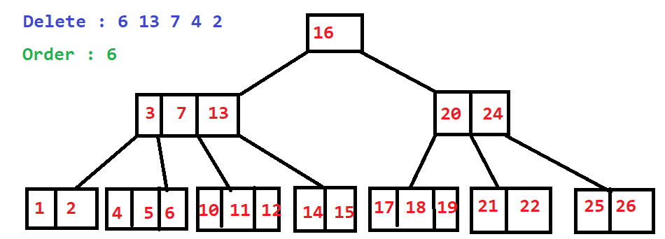
2. Deletion Example

